Slide 1
Tailings Dam Circuit Protection Project

Slide 2
What is the scope?
What are we trying to protect?
Options:
The cable
The starter motor from a short circuit event.
The starter motor from overload current during cranking.
The low-voltage electrical load.
The cable from a short circuit event.
The vehicle
What can the developed fuse tool do?
Here is a simplified version of what the tool can do
Checks what’s present in the vehicle against the electrical operational boundary conditions.
Suggests replacing the battery/ motor/ cable if it is operating beyond the boundary conditions.
Suggest what cable, and fuse best fits the application.

Slide 3
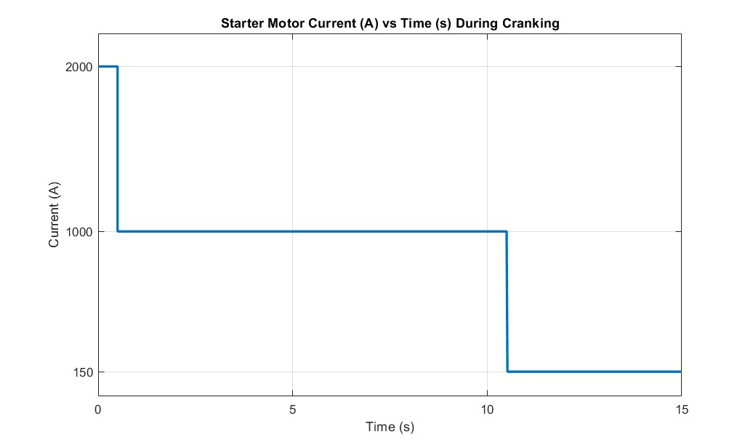
Let’s understand the Fusing and Cable requirements
Inrush current 2000A lasting less than 1 s
In this example, the starter motor current is plotted against time, from when the engine is cranking to when it starts. We can see that the fuse and cable must meet three conditions.
Inrush current
Cranking current
Continuous load current
Continuous load current 150 A demand after the engine starts
Cranking current 1000A lasting for less than 10 s

Slide 4
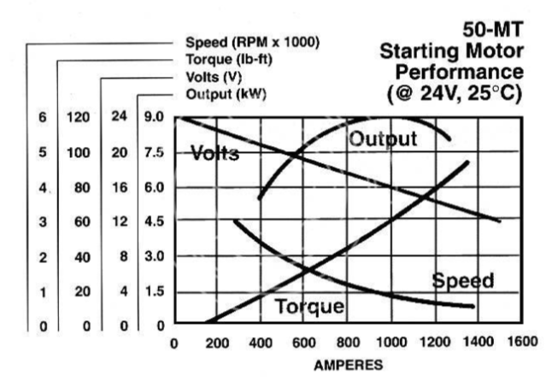
Let’s Understand the electrical and mechanical characteristics of 24V starter motors.
This graph shows a 50-MT starter motor, commonly used in heavy machinery that operates on a 24V electrical system.
In such systems, 16V is the minimum voltage threshold; falling below this level can cause critical electrical components to fail or the machinery does not turn ON.
This failure occurs because these components rely on a minimum voltage to maintain stable performance in onboard electronics, control systems, and other low-voltage subsystems.
Hence, the cranking amps for 16V were obtained from the graph and set as one of the electrical boundary conditions.
Lowest battery voltage Input cut-off
Max cranking current cut-off

Slide 5
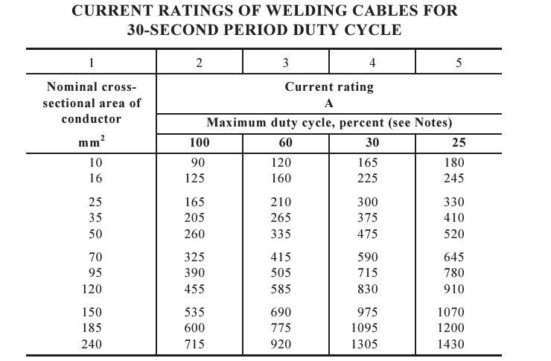
Let’s Understand the welding cable’s current rating-based duty cycle from AS/NZ 1995:2003
In the AZ/NZ 1995:2002 welding cable standard, there are three tables outlining duty cycles: 30 seconds, 5 minutes, and 10 minutes.
When we focus on the 30-second duty cycle for cranking, we can estimate how much current a 120 mm² cable can handle for 10 seconds.
Although the table does not specify the performance at a 33% duty cycle—where the current is drawn for 10 seconds followed by a 20-second cooling period, we can interpolate the value, which is approximately 782 A.
To handle 1000 A, the duty cycle required is roughly 19.37%, corresponding to a duration of about 5 seconds.
30% of a 30-second duty cycle means that the cable draws cranking current for 9 seconds and then cools for 21 seconds before another attempt.
A 120mm2 welding cable can only handle 830A for 9s

Slide 6
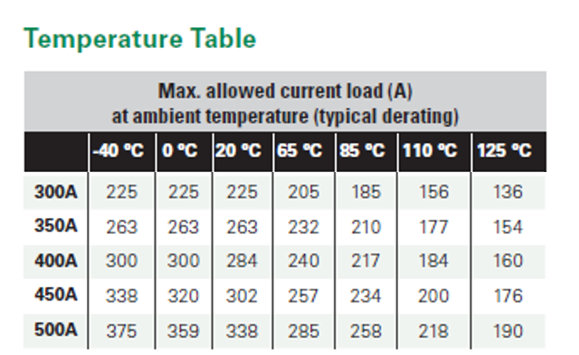
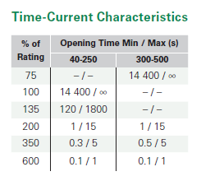
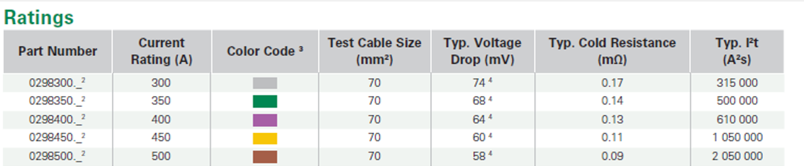
Let’s Understand what the slow blow low voltage fuses can do.
There were limited options for slow-blow fuses, and here is an example of a fuse that partially satisfies the requirements.
Let us consider the 500A fuse; here is what it can handle.
Short circuit current : 256MA for 8 ms.
Inrush current: 2000A for ~0.8 s.
Cranking current: 1000A between 1 to 15 seconds
Continuous current: 359A during cold ambient conditions.

Slide 7
Now, What is the dilemma?
Why doesn’t the manufacturer fuse the starting circuit?
Fusing a starter motor could be counterproductive in applications where immediate operation is critical.
Starter motors draw significantly higher currents during startup, which can blow a fuse.
We cannot protect the starter motor and the cable simultaneously during the cranking event. The fuses currently available on the market do not meet these requirements.
The fuse will not be able to withstand the cranking time required during servicing, such as when bleeding fuel.
Even if we continue fusing the starting circuit, other factors could lead to a thermal event or other undesirable situations. These include the battery or starter motor reaching the end of its lifespan, loose battery cable connections, and worn-out cables.

